Slide 1
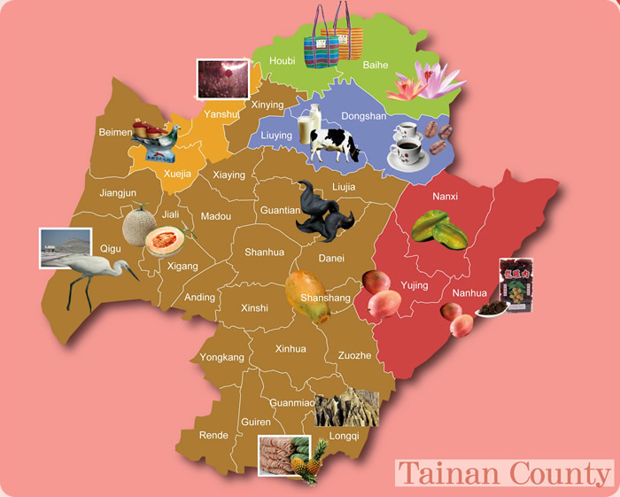
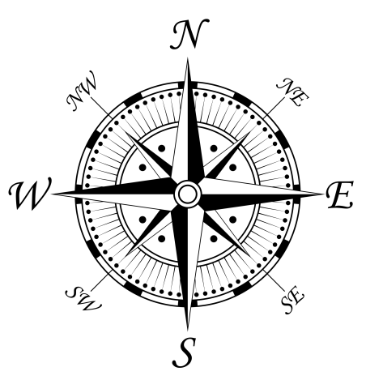
Tainan Trip

Slide 2


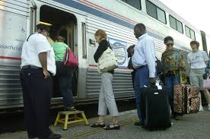
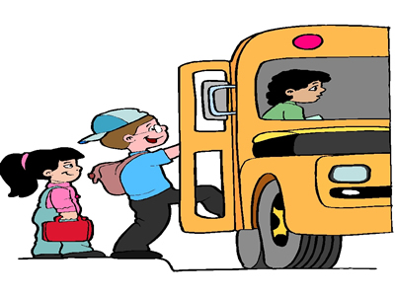
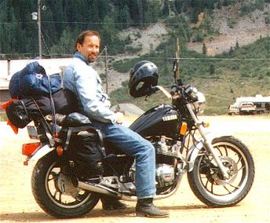
Let’s
take a trip!

Slide 3
Where can we
take a trip to?
Where can we go?

Slide 4

Let’s take a trip to
a place in Tainan!

Slide 5
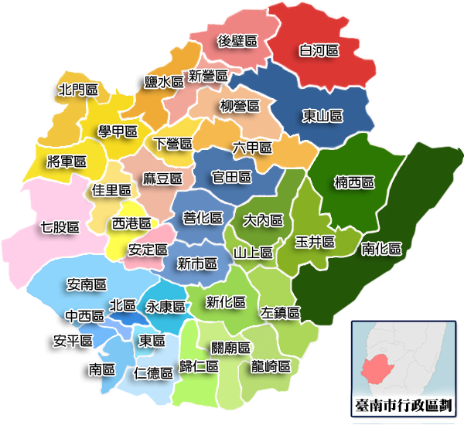
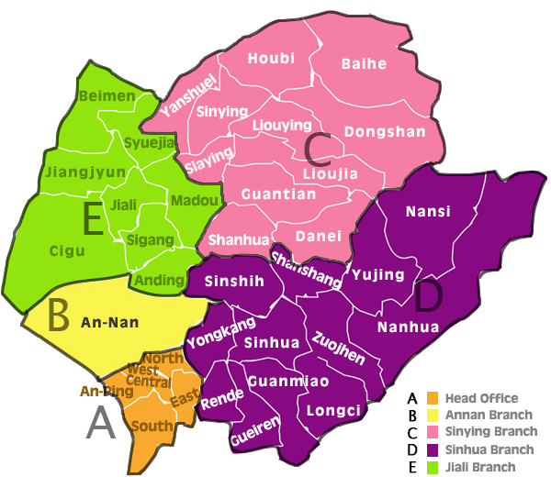
What places in Tainan do you know?

Slide 6




North
West
East
South

Slide 7
Let’s take a trip to a place in North Tainan.

Slide 8
Where can we go in North Tainan?

Slide 9
Yansheui (鹽水) is in North Tainan?

Slide 10
Do you know Yansheui?

Slide 11
Yansheui is in North Tainan?

Slide 12
How can we go to
Yansheui?
How can we go to
North Tainan?
Let’s go by
car.

Slide 13

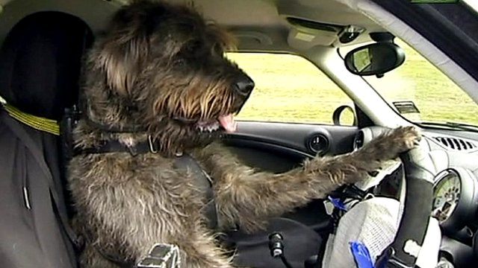

We can go North
by car.

Slide 14

We can go to Yansheui
by car.

Slide 15

We’re in Yansheui!

Slide 16
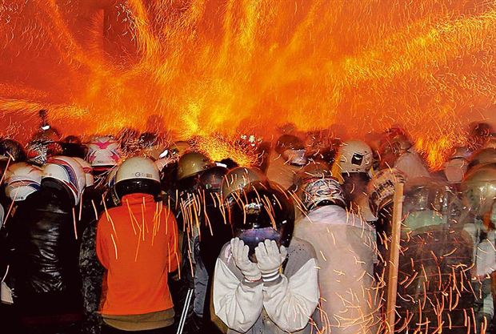
Yansheui has fireworks!

Slide 17


Fireworks

Slide 18
Fireworks Game

