Slide 1




North
West
East
South

Slide 2
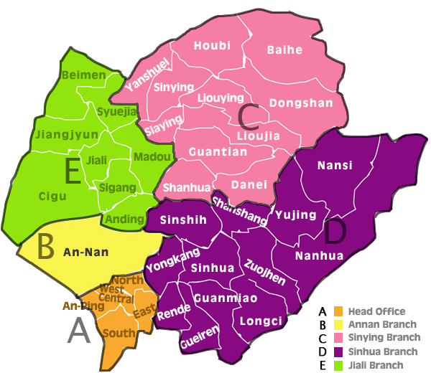
Let’s take a trip to a place in South Tainan.

Slide 3
Where can we go in
South Tainan?

Slide 4
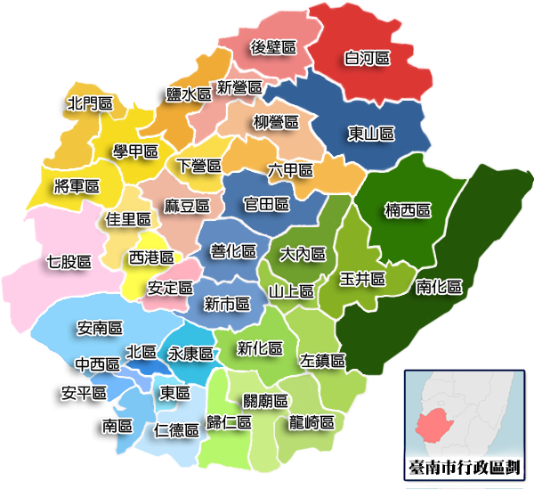
Rende (仁德) is in
South Tainan?

Slide 5
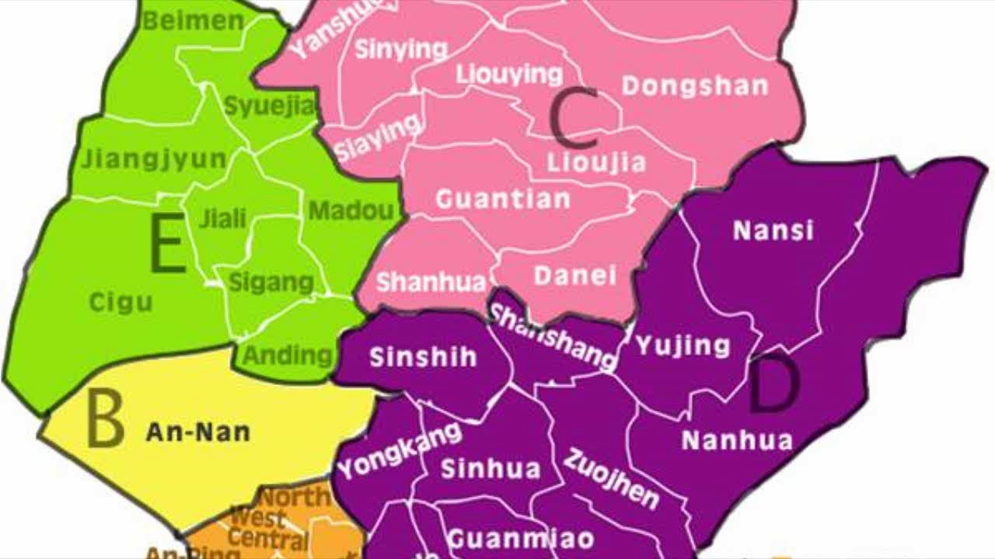
Do you know Rende?

Slide 6

Rende is in South Tainan.

Slide 7
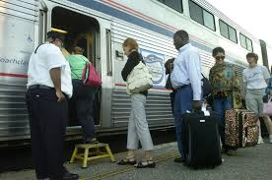

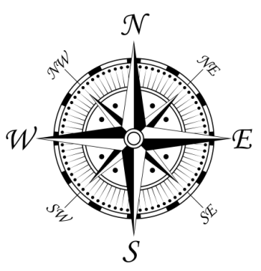
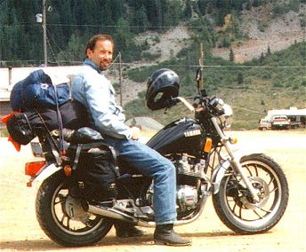
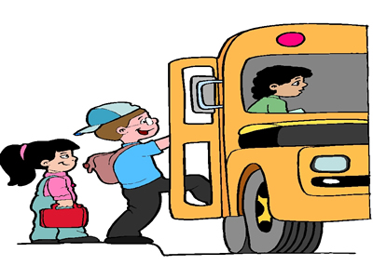
How can we go to
South Tainan?
Let’s go by
train.
How can we go to
Rende?

Slide 8

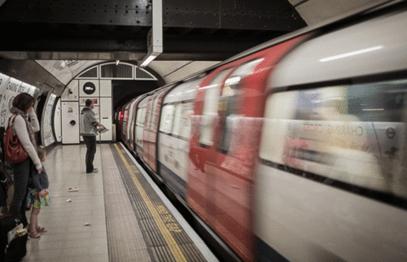
We can go South
by train.

Slide 9
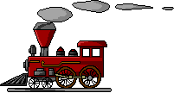
We can go to Rende
by train.

Slide 10
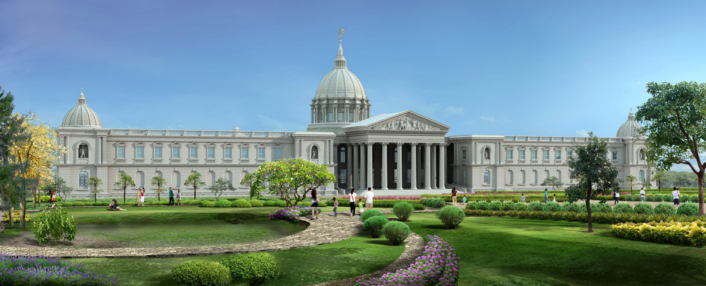
We’re in Rende!

Slide 11
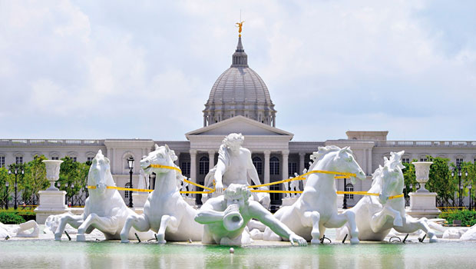
Rende has Chimei Museum

Slide 12

Let’s play museum game!

Slide 13
North
West
East
South

Slide 14
Let’s take a trip to a place in West Tainan.

Slide 15
Where can we go in
West Tainan?

Slide 16

Do you know Cigu?

Slide 17
Cigu is in West Tainan.

Slide 18
How can we go to
West Tainan?
How can we go to
Cigu?
Let’s go by
motorcycle.

