Slide 1
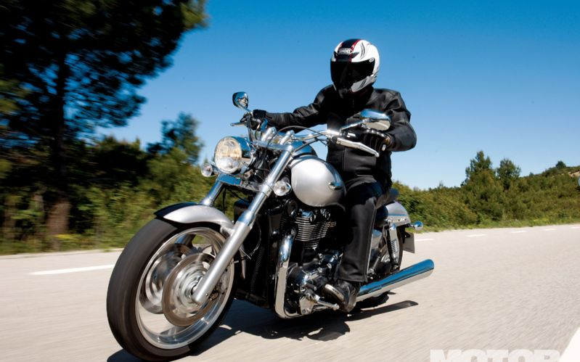
We can go West
by motorcycle.

Slide 2
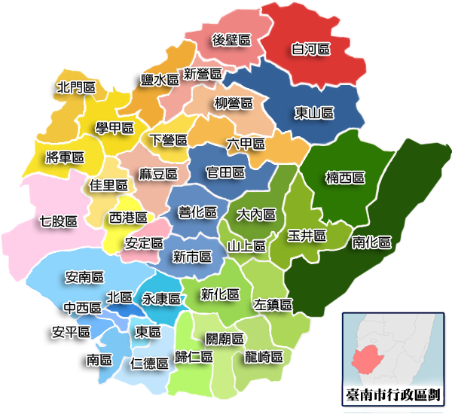
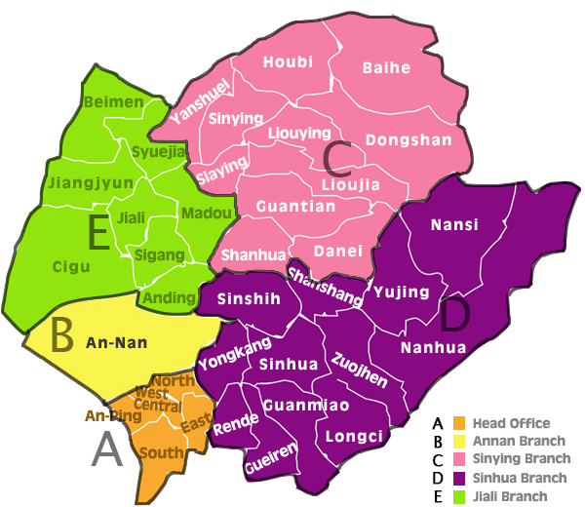
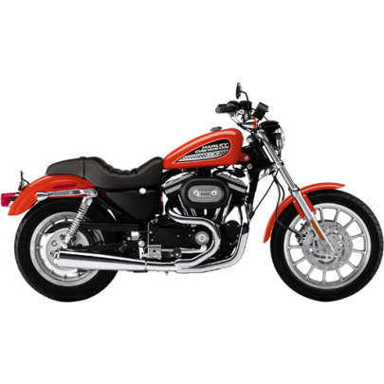
We can go to Cigu
by motorcycle.

Slide 3
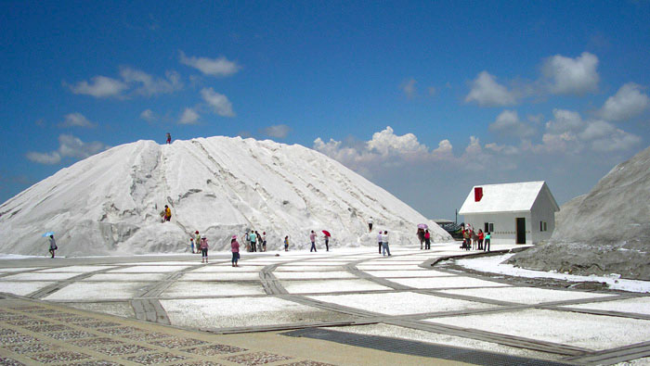
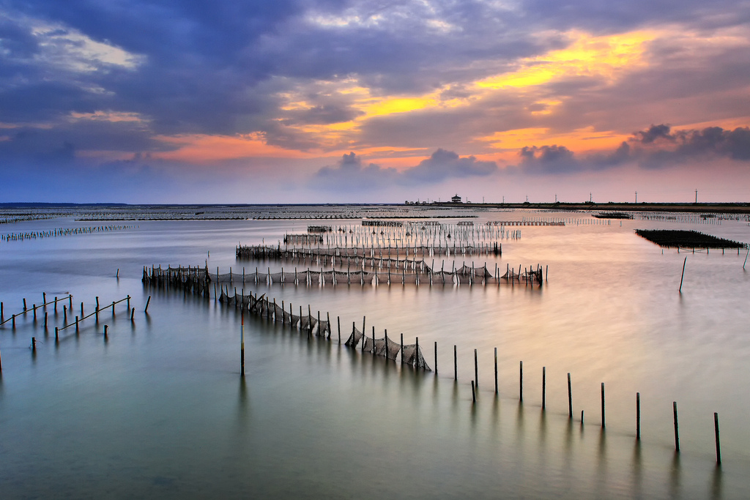
We’re in Cigu!

Slide 4
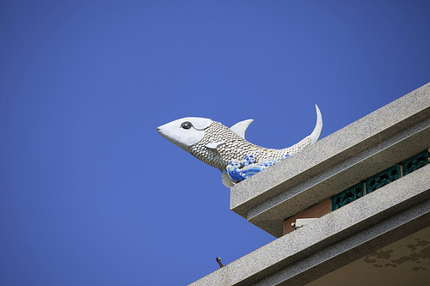
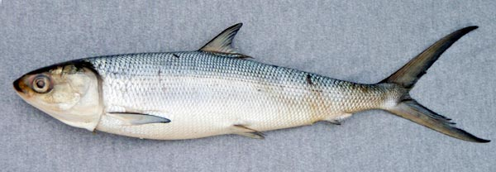
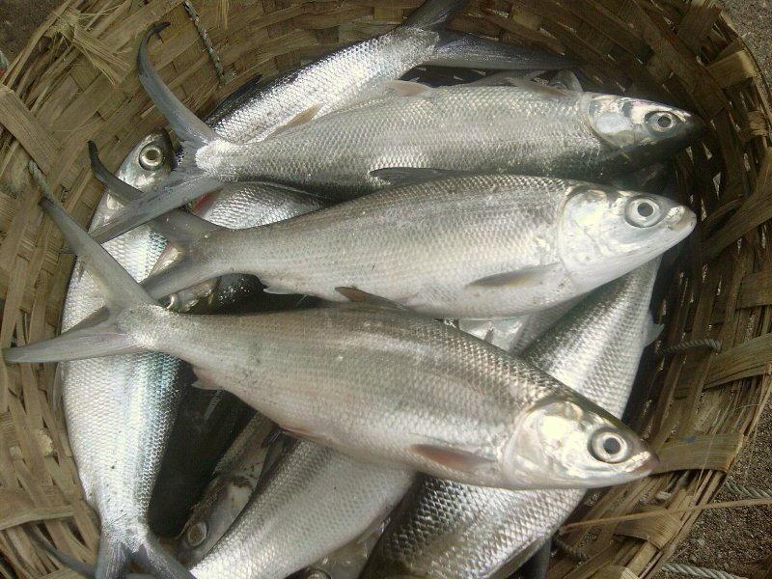
Cigu has milkfish.
虱目魚

Slide 5
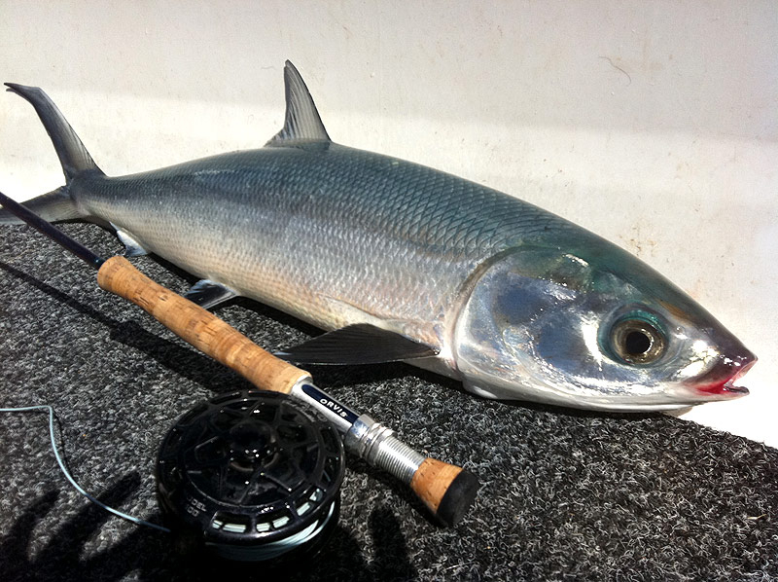
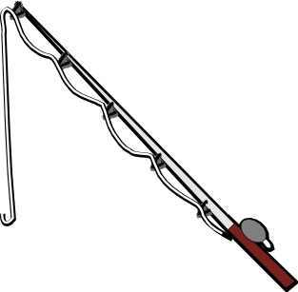
Let’s play a fishing game!

Slide 6
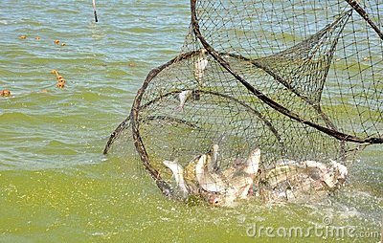

Slide 7




North
West
East
South

Slide 8
Let’s take a trip to a place in East Tainan.

Slide 9
Where can we go in East Tainan?

Slide 10

Do you know Nansi?

Slide 11
Nansi is in East Tainan.

Slide 12
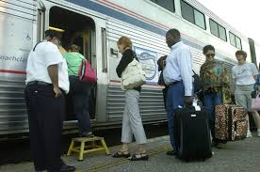
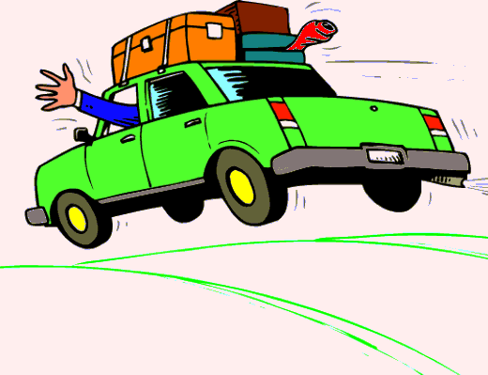
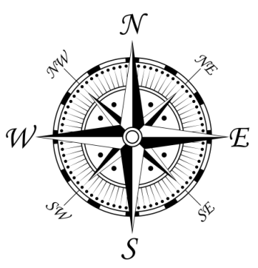
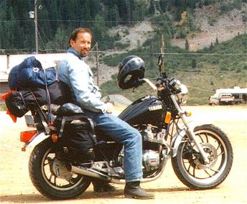
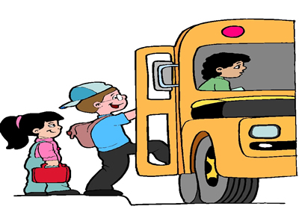
How can we go to
Nansi?
How can we go to
East Tainan?
Let’s go by
bus.

Slide 13
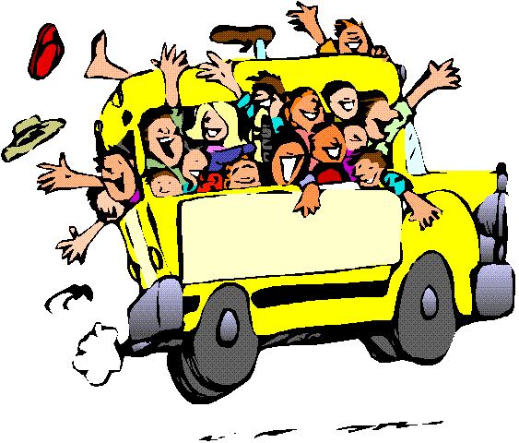

We can go East
by bus.

Slide 14
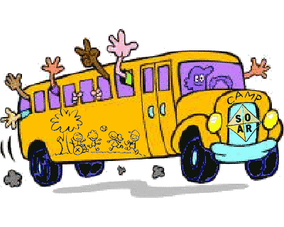
We can go to Nansi
by bus.

Slide 15
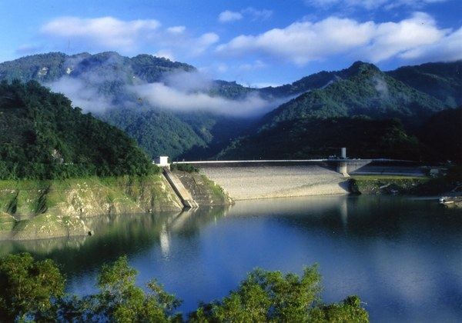
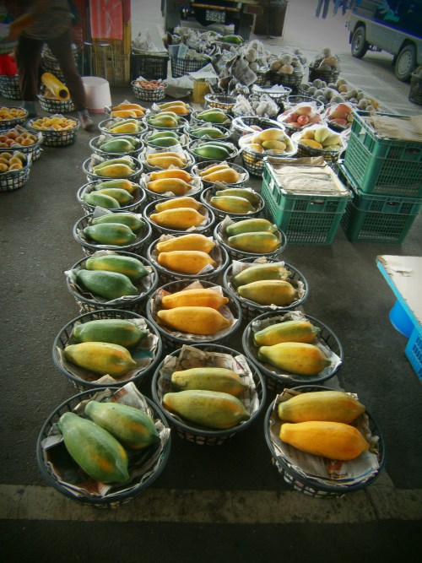
We’re in Nansi!

Slide 16
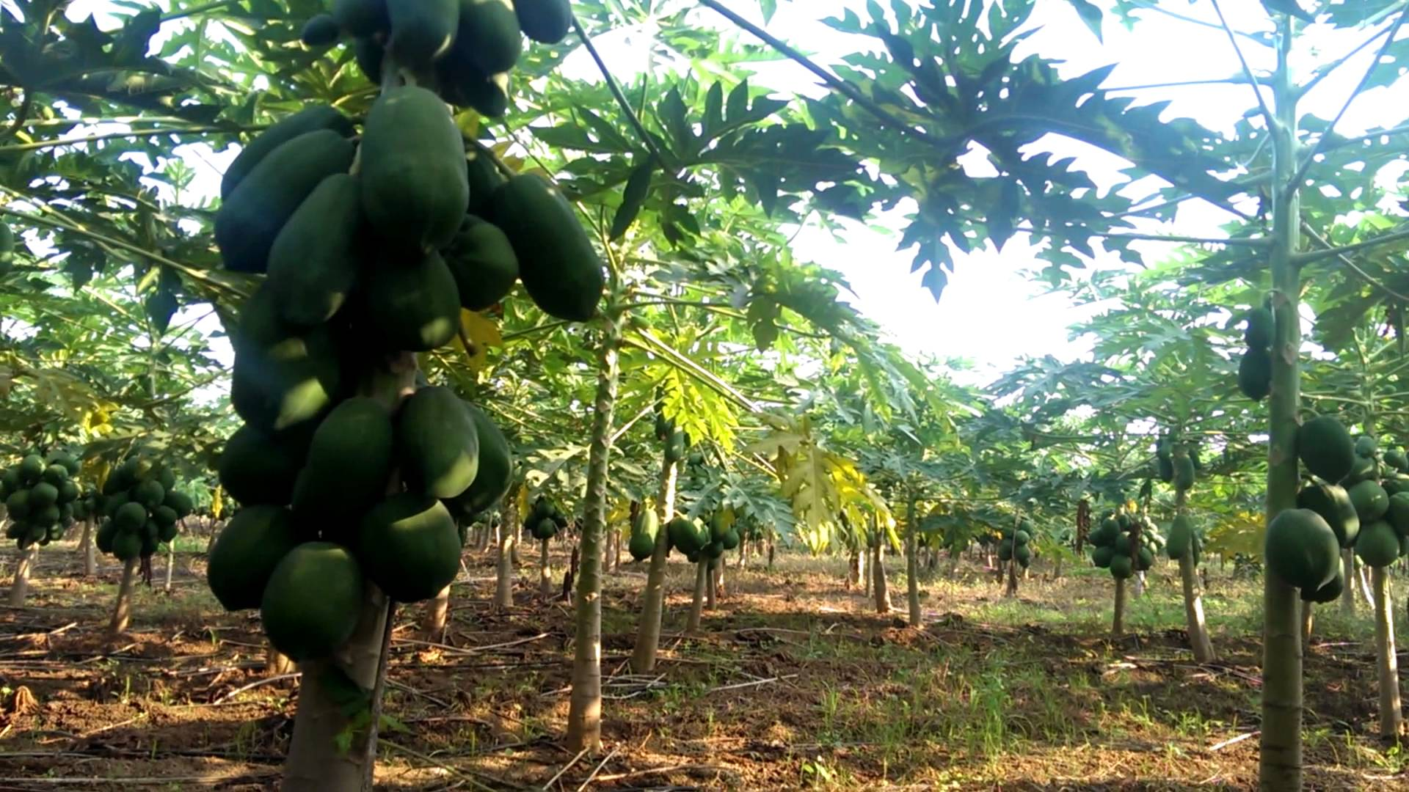
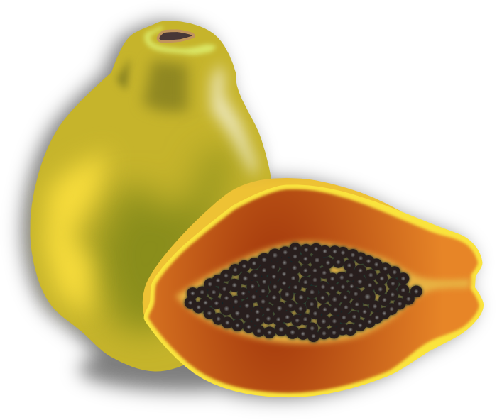
Nansi has papaya.

Slide 17
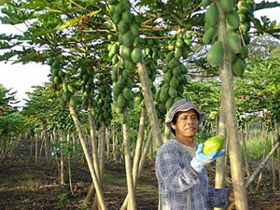
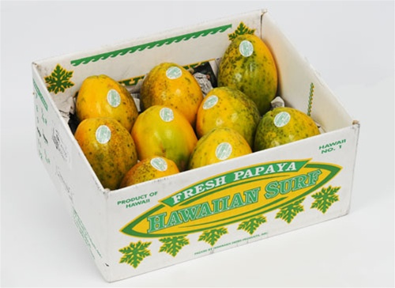
Let’s play a papaya game!

Slide 18
Let’s take a trip.
Let’s take a trip.
Where should we take a trip to?
Where should we go?
Let’s take a trip to a place in Tainan.
Do you know any places in Tainan?
Where in Tainan should we take a trip to?
Where in Tainan should we go?
North, East, South, West???
Let’s take a trip to a place in the North of Tainan.
Where can we go in the North of Tainan?
Let’s go to Yun Shui
How can we go to Yun Shui.
Let’s go by car.
Let’s go North by car.
Let’s go to Yun Shui by car.

Slide 19
